Slide 1
Sense-Hat Controlled Pictionary Game
ELE 408
Nicholas Clavette
Johann Karl Muller

Slide 2


Slide 3
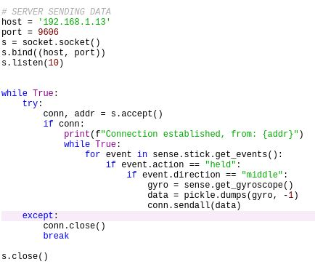
Server for sending Gyroscope Data
Require RaspberryPi to do as little as possible, so that it can send data as quickly as possible
Using pickle to encode dictionary element returned by get_gyroscope()
Only sending data when the joystick button is held down

Slide 4
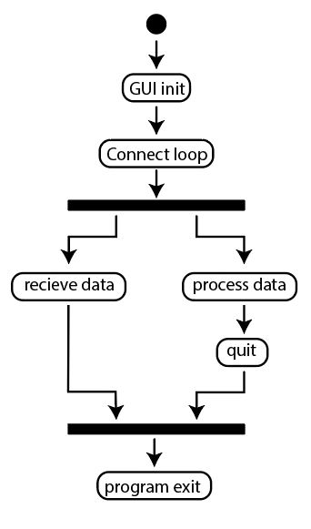
Client for receiving Gyroscope Data
Threaded process allows tkinter to handle the graphics, and a separate function to receive data
once the GUI connects to the server, a thread to receive the data is started
a shared data queue allows the main thread to process data from the data queue

Slide 5
Remaining technical requirements
Create raspberry pi connection and calibration menu in GUI
Adapt mouse cursor input to direct drawing of circles on a canvas from Lab 6 to roll and yaw data received from sensehat
Lines will be drawn when the data queue is not empty
Application will still function with latency
Save and upload image of canvas to HTML website at some arbitrary frequency

Slide 6
Thank you
Any Questions?

